Slide 1
Year 4 Multiplication Tables Check
Parents information

Slide 2
Why are times tables important?
Times tables support children and under pin everything within Maths eg. telling the time, fractions.
It is vital that all children know their multiplication facts up to 12 x 12 by the end of Year 4.

Slide 3
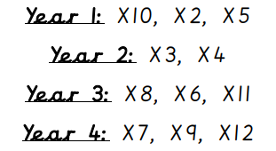
Which times tables should my child know?

Slide 4
The Multiplication Tables Check:
The purpose of the check is to determine whether your child can fluently recall their times tables up to 12, which is essential for future success in mathematics. It will also help us (at school) to identify if your child may need additional support.
The test is statutory for all Year 4 pupils in Primary School in the UK.

Slide 5
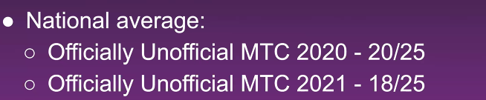
What is it?
It is an on-screen check consisting of 25 times table questions. Your child will be able to answer 3 practice questions before taking the actual check. They will then have 6 seconds to answer each question. On average, the check should take no longer than 5 minutes to complete.
Each child will get a score out of 25.
There is no pass mark for the check.
Our aim is for our children to score at least 22/25.

Slide 6
When is it?
We have a 2 week window to complete the test from Monday 3rd June 2024.

Slide 7
Will I find out my child’s score?
Yes. Your child’s teacher will share your child’s score with you, as they would with all national curriculum assessments.

Slide 8
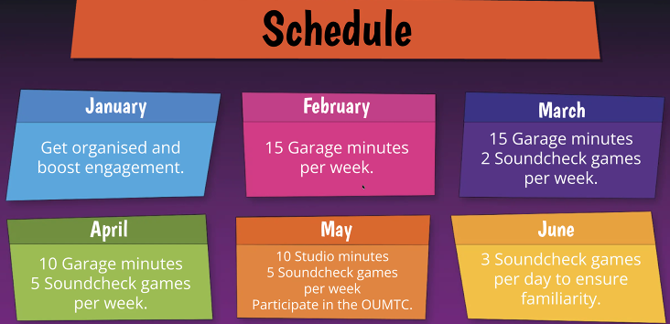
How are we helping to prepare your child in school?
We teach children their times tables in school.
We have set ‘sessions’ on TTRS to help to prepare children for the check.
We will be running a TTRS club which children can attend weekly.

Slide 9
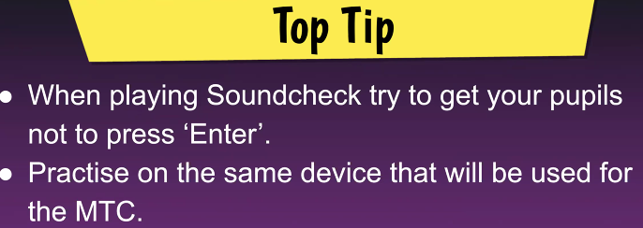

How can you help to prepare your child?
Encourage your child to learn their times tables by:
Writing down the calculations eg. 4 x 8 = 32
Writing down the multiples in order eg. 4, 8, 12, 16 …
Chanting the multiples aloud
Use TTRS (especially the Sound Check)

Slide 10
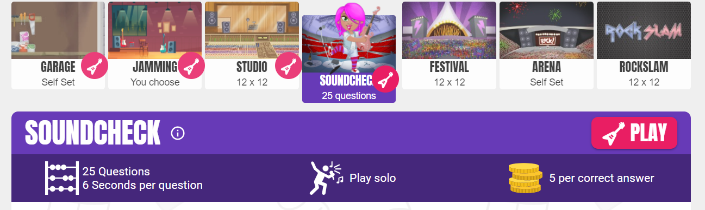
Example- this is very similar to the MTC.
TTRS Sound Check

