Slide 1
Little Daisies Parent/Carer Phonics Meeting

Slide 2
Why teach phonics?
The ability to read and write well is a vital skill for all children, paving the way for an enjoyable and successful school experience.
Phonics helps children to develop good reading and spelling skills

Slide 3
What is Phase 1?
Phase 1 in Phonics is not about learning the sounds with flashcards it is about getting ready to learn the sounds. It is primarily speaking and listening activities.
Phase 1 concentrates on developing children's speaking and listening skills and lays the foundations for the next phases. The emphasis during Phase 1 is to get children attuned to the sounds around them and ready to begin developing oral blending and segmenting skills.
Being secure in Phase 1 is vital to future success in phonics.
It is split into 7 aspects which we will go through.
It is really good fun!

Slide 4
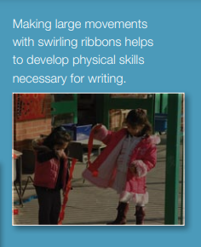
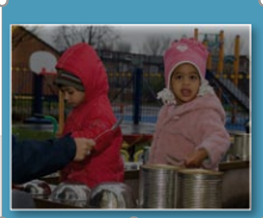
General sound discrimination – environmental
The aim of this aspect is to raise children's awareness of the sounds around them and to develop their listening skills.
Activities include going on a listening walk, drumming on different items outside and comparing the sounds, playing a sounds lotto games and making shakers. https://www.youtube.com/watch?v=VOlE5Gi-oBY
https://www.bbc.co.uk/teach/school-radio/articles/zbc4y9q
Notes:
Loud, quiet, fast, slow.

Slide 5
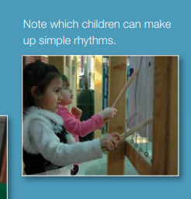
General sound discrimination – instrumental
This aspect aims to develop children's awareness of sounds made by various instruments and noise makers.
Activities include comparing and matching sound makers, playing instruments alongside a story and making loud and quiet sounds.

Slide 6
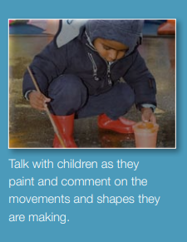
General sound discrimination – body
The aim of this aspect is to develop children's awareness of sounds and rhythms.
Activities include singing songs and action rhymes, listening to music and developing a sounds vocabulary.
Notes:
Wind the bobbin up and if you’re happy and you know it
Clap, clap, stamp.

Slide 7
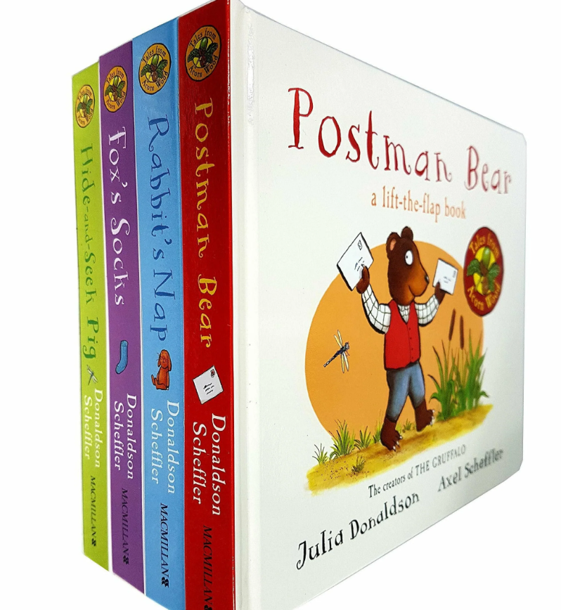
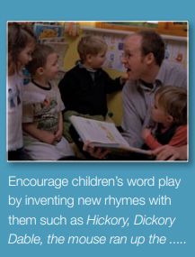
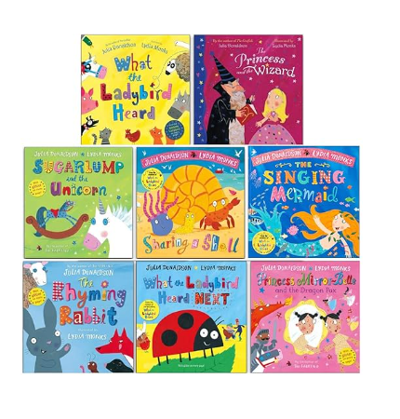
Rhythm & rhyme
This aspect aims to develop children's appreciation and experiences of rhythm and rhyme in speech.
Activities include rhyming stories, rhyming bingo, clapping out the syllables in words and odd one out.

Slide 8
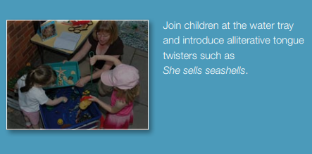
Alliteration
The focus is on initial sounds of words, with activities including I-Spy type games and matching objects which begin with the same sound.
For example a sentence with all of the same sounds at the beginning … silly sausages sizzle slowly.

Slide 9
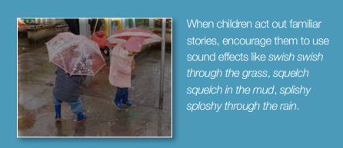
Voice Sounds
Make your own voice sounds (e.g. going down a slide/ keep everyone quiet/ buzz like a bee).
The aim is to distinguish between different vocal sounds and to begin oral blending and segmenting. Activities include Metal Mike, where children feed pictures of objects into a toy robot's mouth and the teacher sounds out the name of the object in a robot voice - /c/-/u/-/p/ cup, with the children joining in.

Slide 10
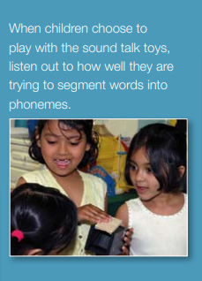
Oral Blending
Oral blending (ready to read) & segmenting (ready to write). • In this aspect, the main aim is to develop oral blending and segmenting skills.
To practice oral blending, the teacher could say some sounds, such as /c/-/u/-/p/ and see whether the children can pick out a cup from a group of objects. For segmenting practice, the teacher could hold up an object such as a sock and ask the children which sounds they can hear in the word sock.

Slide 11
Phase 1 Overview
The activities in Phase 1 are designed to be used throughout all of the phases of phonics as lots of practice is needed before children will become confident in their phonic knowledge and skills.
Our Phase 1 programme is 5-10 minute’s of fun, practical activities which caters for all different learning styles. This is over your child’s year in Pre-School.

Slide 12
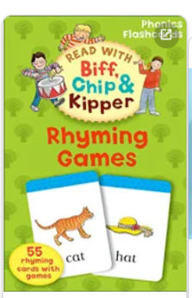
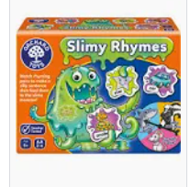
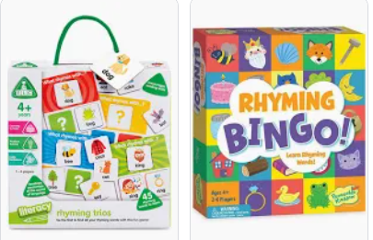
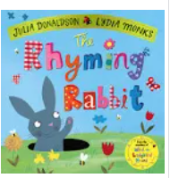
How can I help at home?
Play ‘I spy’ with sounds not the alphabet names
Sing lots of nursery rhymes
Choses stories that use alliteration
Play pairs with words and pictures
Play sound bingo games
Play lots of party games like Musical statues
Read lots of rhyming books
Rhyming cards

Slide 13
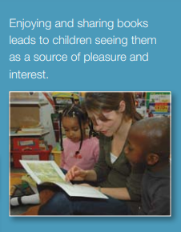
Being read to every day
Reading to your children in the earliest months stimulates the part of the brain that allows them to understand the meaning of language and helps build key language, literacy and social skills.
Evidence suggests that children who read for enjoyment every day not only perform better in reading tests than those who don’t, but also develop a broader vocabulary, increased general knowledge and a better understanding of other cultures.
In fact, reading for pleasure is more likely to determine whether a child does well at school than their social or economic background.

Slide 14
Reading
What this looks like…
1:1 reading with an adult at home at least 3 times a week
Reading a Link text or Topic Text, for example Funny Bones as part of our Family Fortunes topic
Activities linked to the book
Using role play, pictures, puppets and other resources to build up story telling skills
The teacher reads to the children at the end of each day

Slide 15
Reading at home
Make reading purposeful for example read cards, letters, messages etc. together
Play with magnetic letters to leave each other messages
When you are out look at traffic signs, street names, shop names and adverts together
Read stories to your children, make them fun
Talk about what is happening in books and talk about the pictures together
Ask questions during stories for example ‘Why did they do that?’ especially if there is no right answer
Encourage your children to help you read shopping lists and recipes
Play games that encourage reading for example Orchard Games
Surround yourself with books
Read for pleasure yourself

Slide 16

Remember…..
“The more that you read, the more things you will know. The more that you learn, the more places you'll go.” ― Dr. Seuss, I Can Read With My Eyes Shut
Any questions?

